Slide 1
Ecommerce Sales Analysis Using BigQuery
Nikhil Nalawade
Tools:
• BigQuery
• SQL
• GitHub

Slide 2
Project Overview
Objective:
Analyze Google Merchandise Store data using BigQuery SQL.
Dataset:
Project: data-to-insights
Dataset: ecommerce
Table: all_sessions
Tools:
BigQuery, SQL, GitHub

Slide 3
Revenue Analysis
Business Question:
Which cities generate the highest revenue?
Findings:
• Revenue is concentrated in a few cities.
• Top cities contribute significantly to sales.

Slide 4
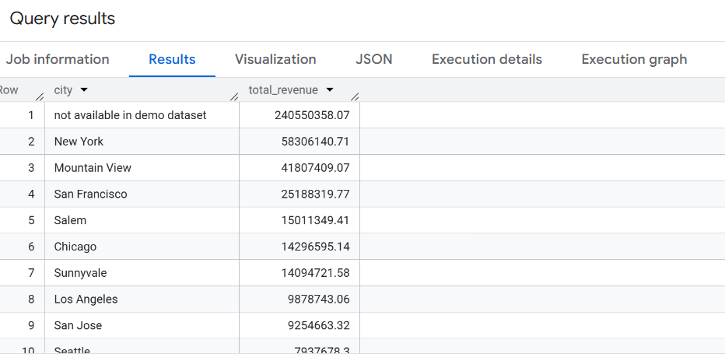
Insert → Pictures → This Device

Slide 5
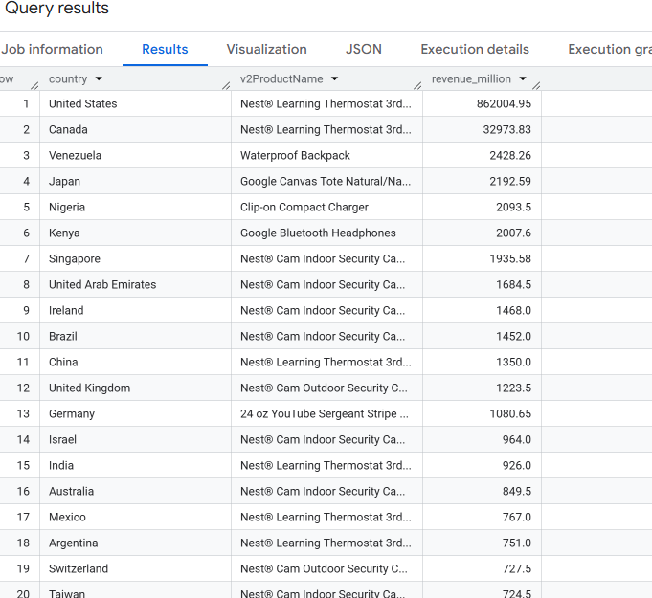
Product Performance

Slide 6
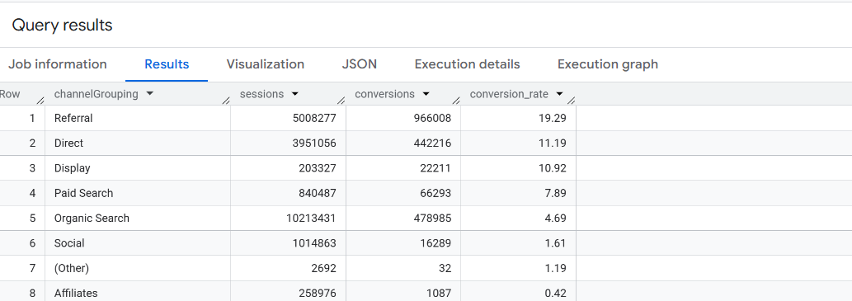
Conversion & Channel Analysis

Slide 7
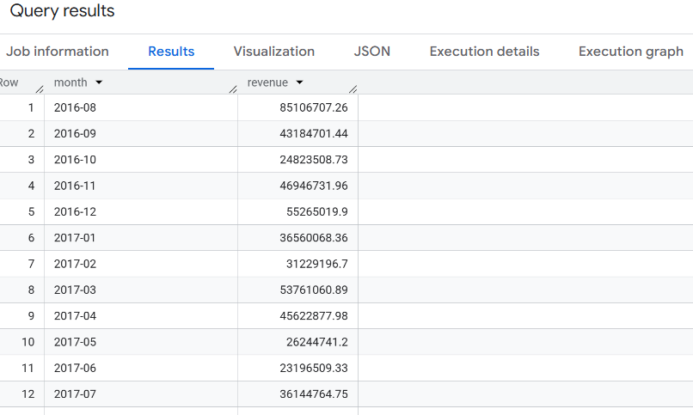
Monthly Revenue & Customer Behavior

Slide 8
Conclusion & Recommendations
Conclusion
Revenue is driven by a few key cities and products.
Conversion rates show opportunities for growth.
Customer and traffic analysis provide valuable business insights.
Recommendations
Focus marketing on high-performing channels.
Promote top-selling products.
Improve checkout experience to increase conversions.

